Slide 1
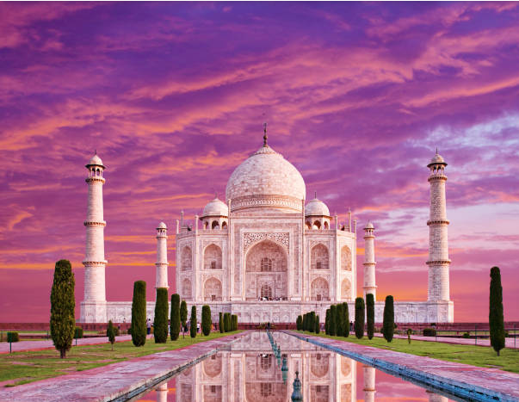
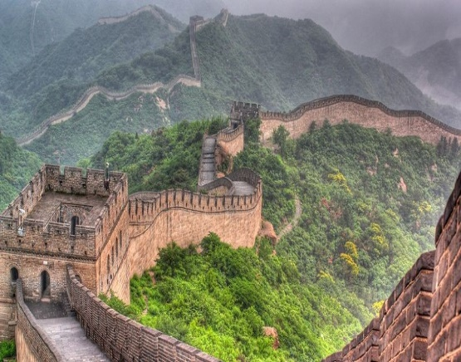
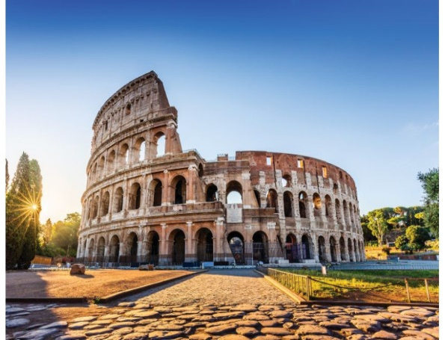
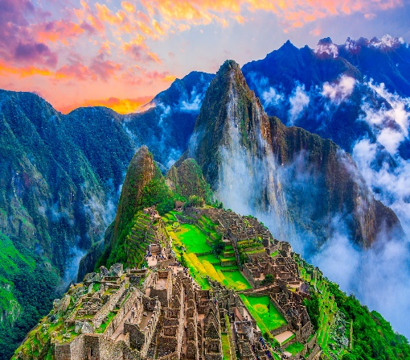
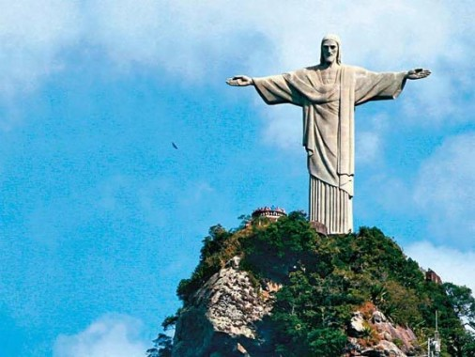
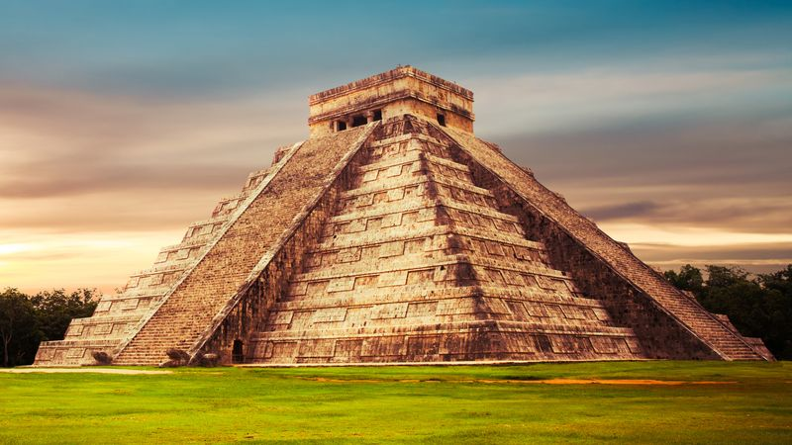
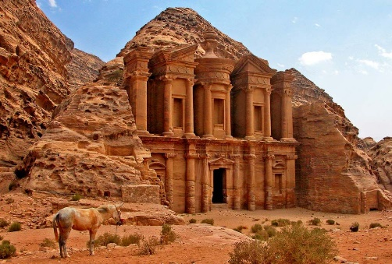
Seven wonders of the world

Slide 2
Seven wonders of the world
TAJ MAHAL ,INDIA
GREAT WALL OF CHINA

Slide 3
Seven wonders of the world
THE COLOSSEUM, ROME,ITALY
MACHU PICCHU,PERU

Slide 4
Seven wonders of the world
CHRIST THE REDEEMER , BRAZIL
CHICHEN ITZA, MEXICO

Slide 5
Seven wonders of the world
PETRA, JORDAN

